Slide 1


Whitgift School, 18th Nov 2022
MycetOS: Open Source Drug Discovery in Schools
Prof Matthew H. Todd
Chair of Drug Discovery, University College London
@mattoddchem
First: what is “Open Source Drug Discovery”?
Second: how have we applied this to mycetoma?
Third: Who?

Slide 2
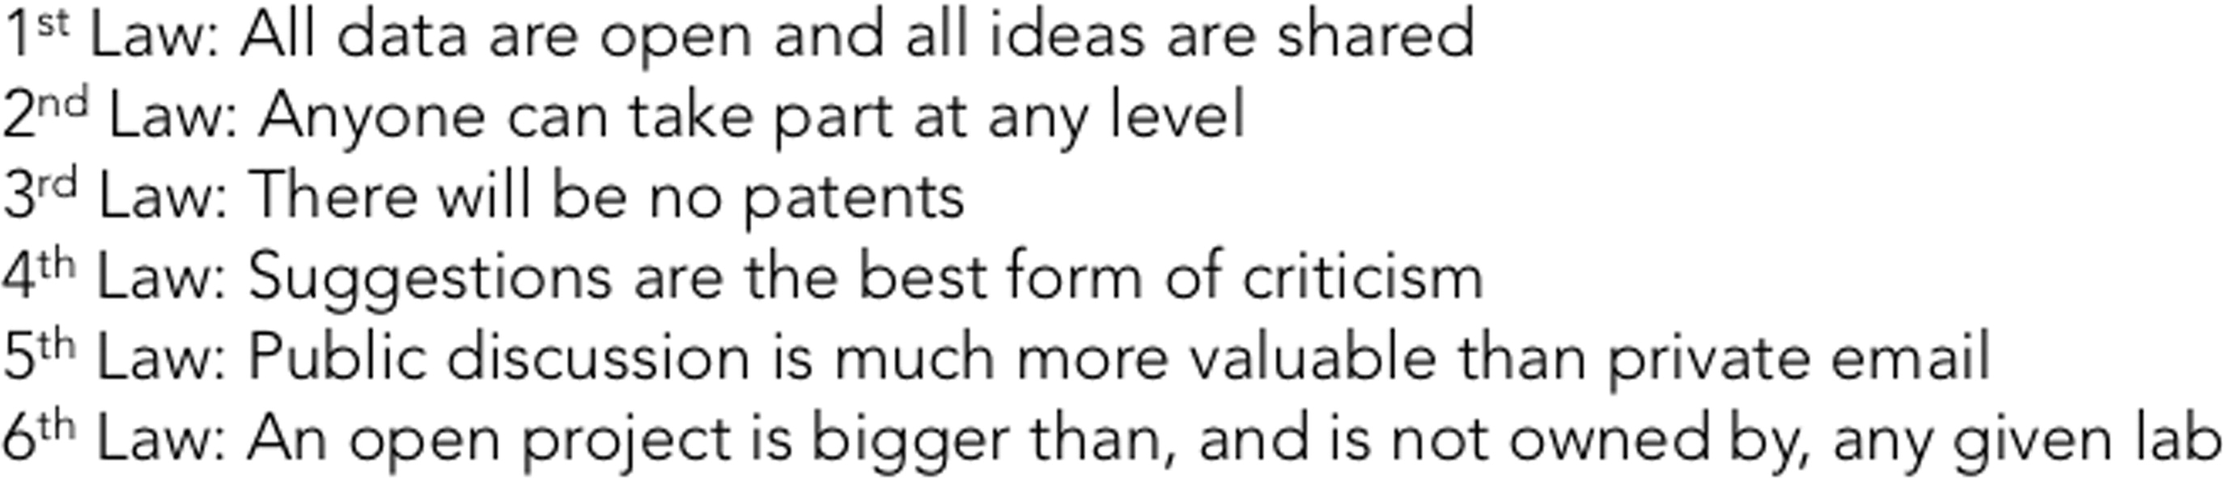
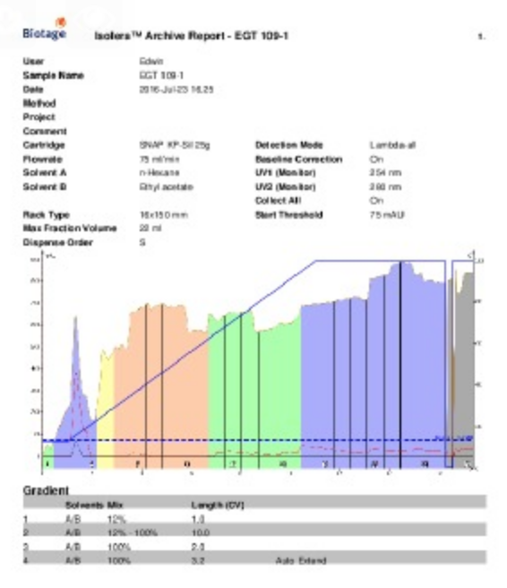
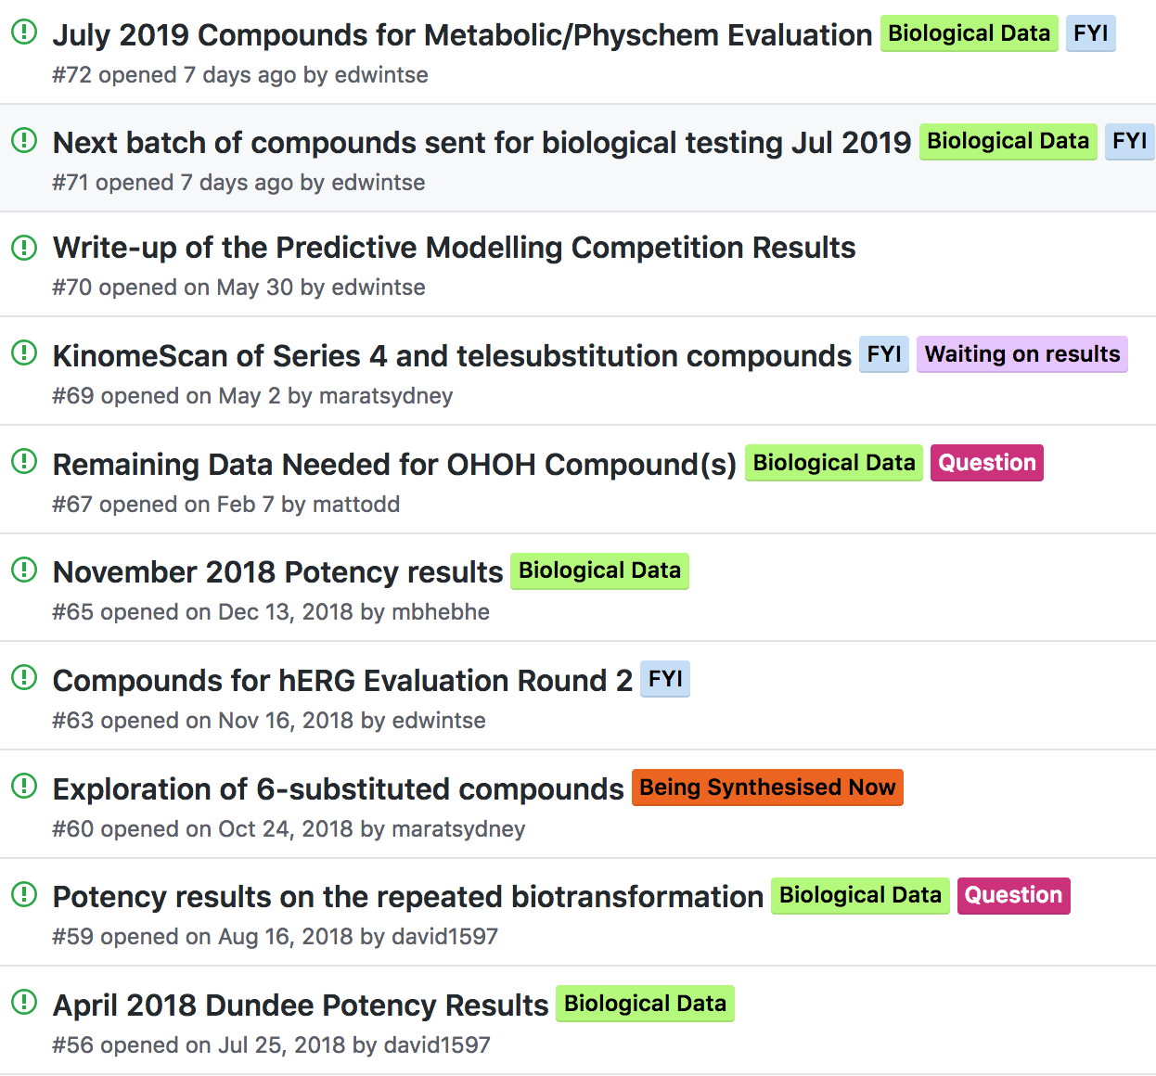
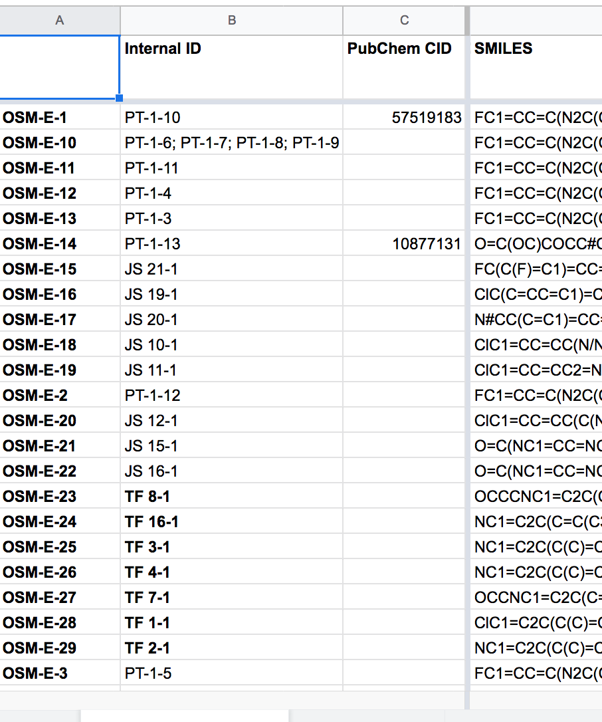
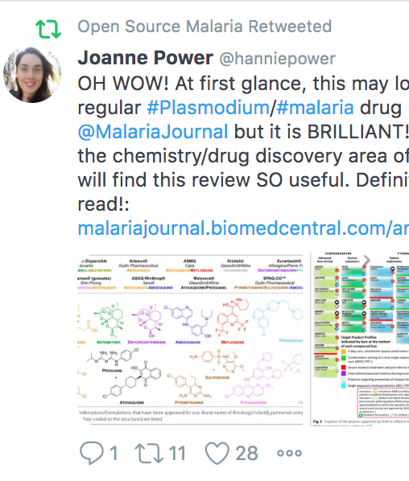
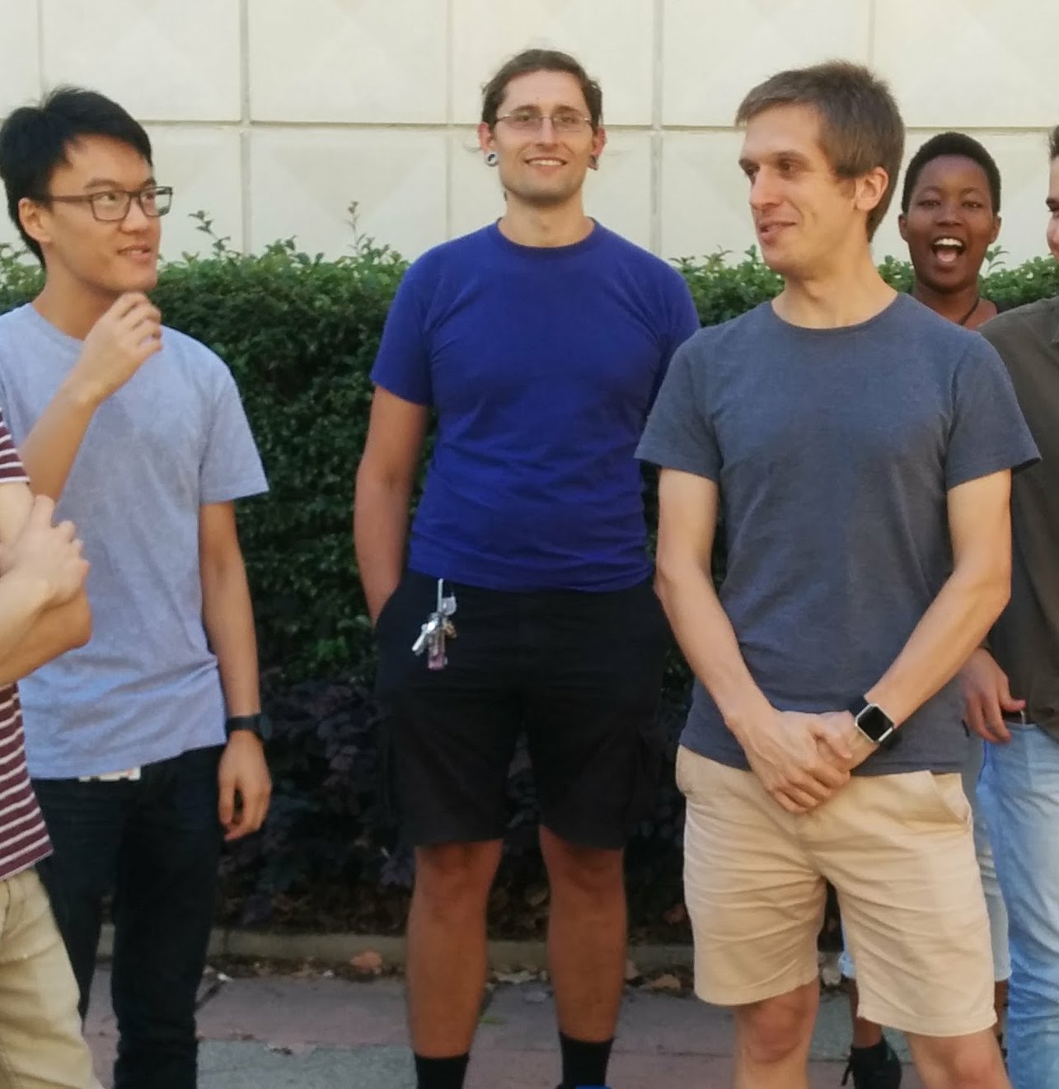
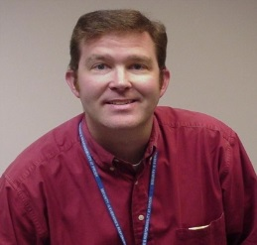
The General Approach
Malaria: ACS Cent. Sci. 2016, 2, 687; J. Med. Chem. 2020, 63, 11585; J. Org. Chem. 2020, 85, 13438. TB: J. Med. Chem. 2018, 61, 11327. Antifungals: PLoS NTD 2018, 12(4): e0006437. Platform: Chem. Sci. 2015, 6, 1614; Parasitology 2014, 141, 148. Laws: ChemMedChem, 2019, 14, 1804.
Components
Contributions
Laboratory Notebooks
Public To Do Lists/Discussion
Open Data
Community
Students
Pharma

Slide 3
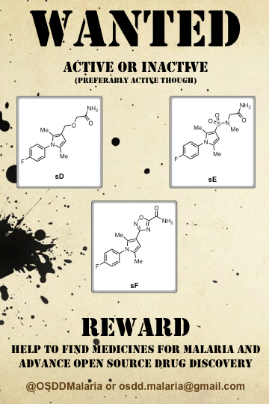
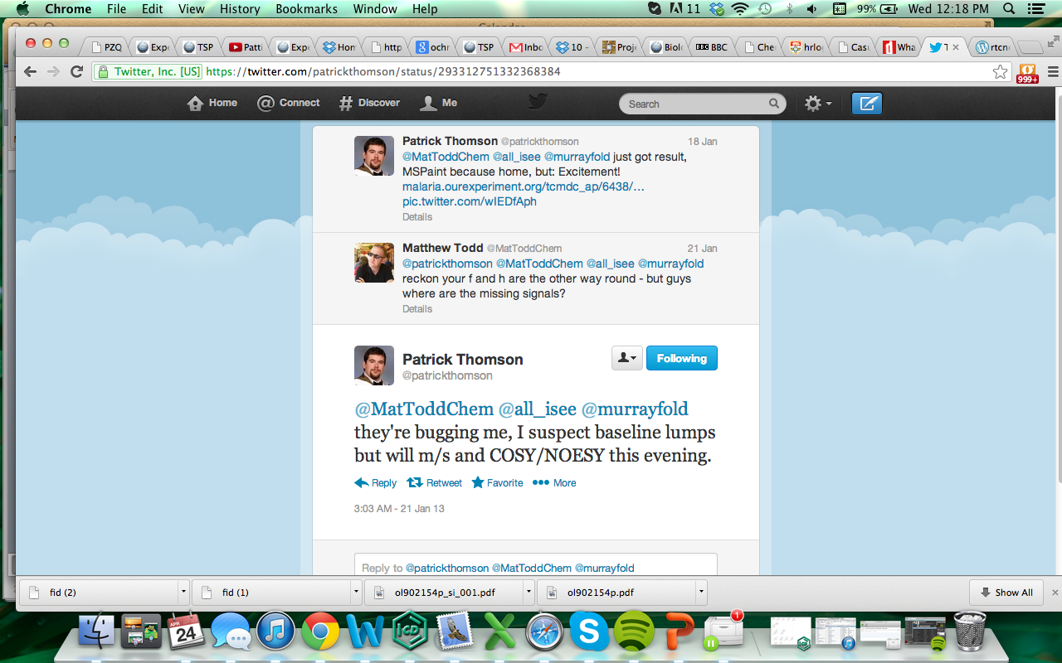
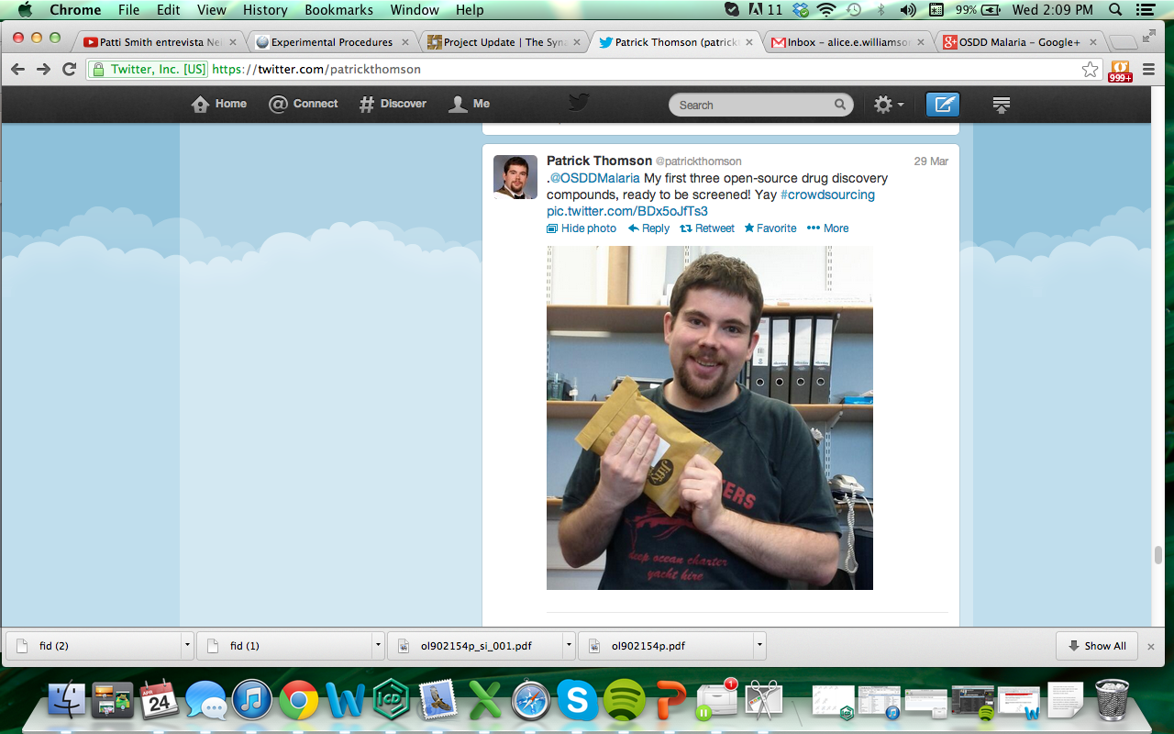
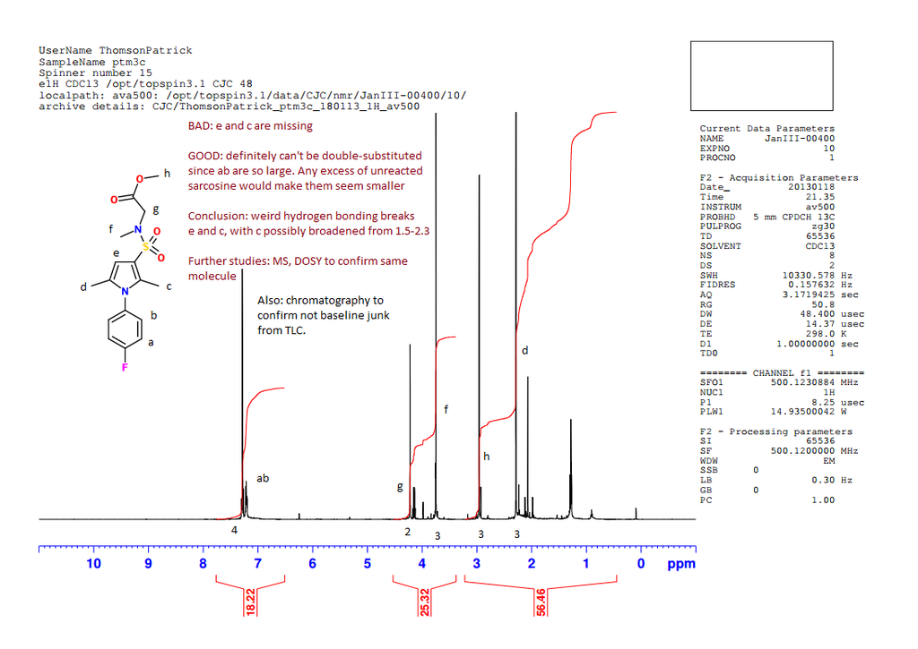
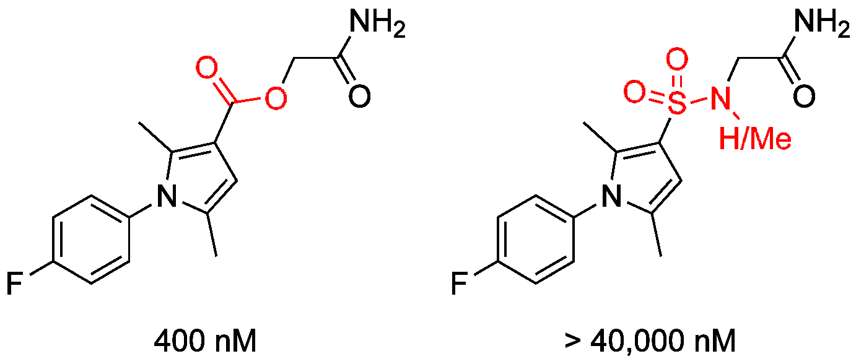
An Example

Slide 4

Highly amenable to
Crowdsourced, Open Educational Initiatives
Nov ’12
Apr ‘13
Nov ‘14
Feb ‘15
Oct ‘15
Mar ‘16
Jun ‘16
’18 –

Slide 5
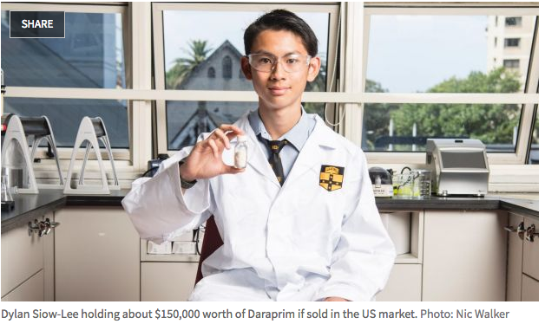
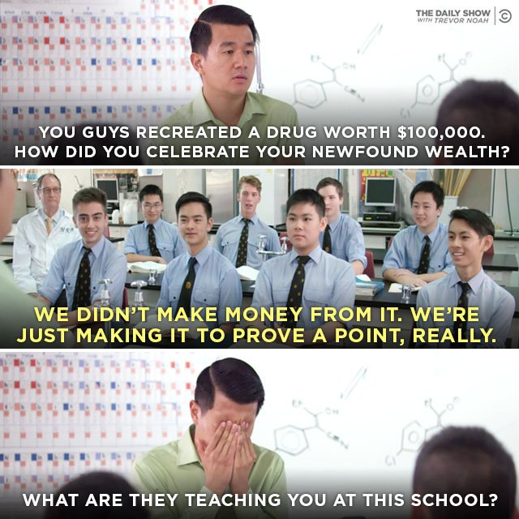

Can Involve Us All
Images: Sydney Morning Herald, The Daily Show with Trevor Noah

Slide 6
Example Workflow in Breaking Good
“Special Studies Program” at The University of Sydney
Ca. 50 students per cohort, about 8 weeks.
Supervised by grad students who help with things that are hard in research lab
With Alice Motion, Ed Tse, Marat Korsik, Peter Rutledge

Slide 7
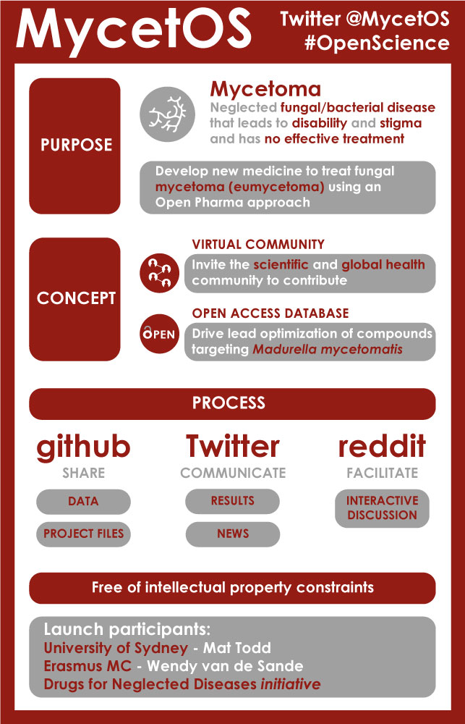
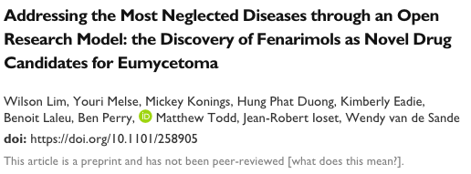
Open Source Mycetoma
Partnership with DNDi
PLoS NTD 2018, 12(4): e0006437

Slide 8
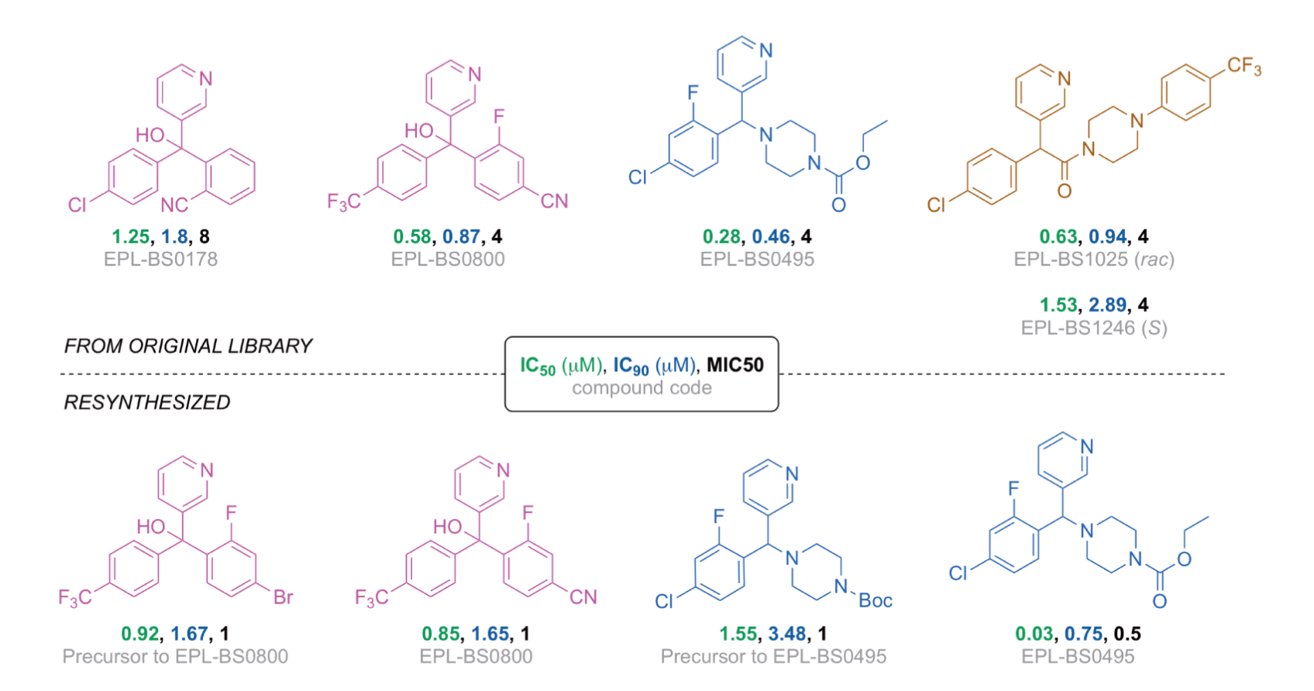
Example Molecules
Addressing the Most Neglected Diseases through an Open Research Model: the Discovery of Fenarimols as Novel Drug Candidates for Eumycetoma
W. Lim, et al. PLoS NTD 2018, 12(4): e0006437.

Slide 9
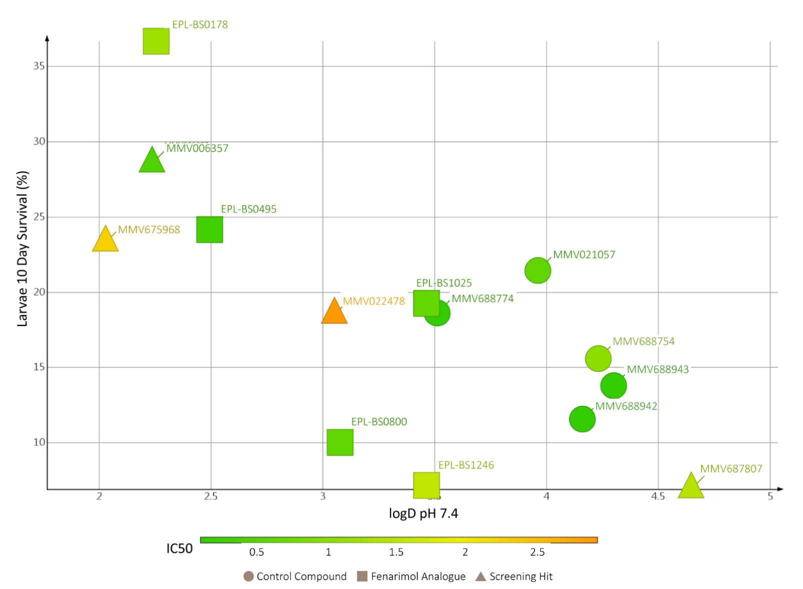
Grain Penetration as Key?
Addressing the Most Neglected Diseases through an Open Research Model: the Discovery of Fenarimols as Novel Drug Candidates for Eumycetoma
W. Lim, et al.
PLoS NTD 2018, 12(4): e0006437.

Slide 10
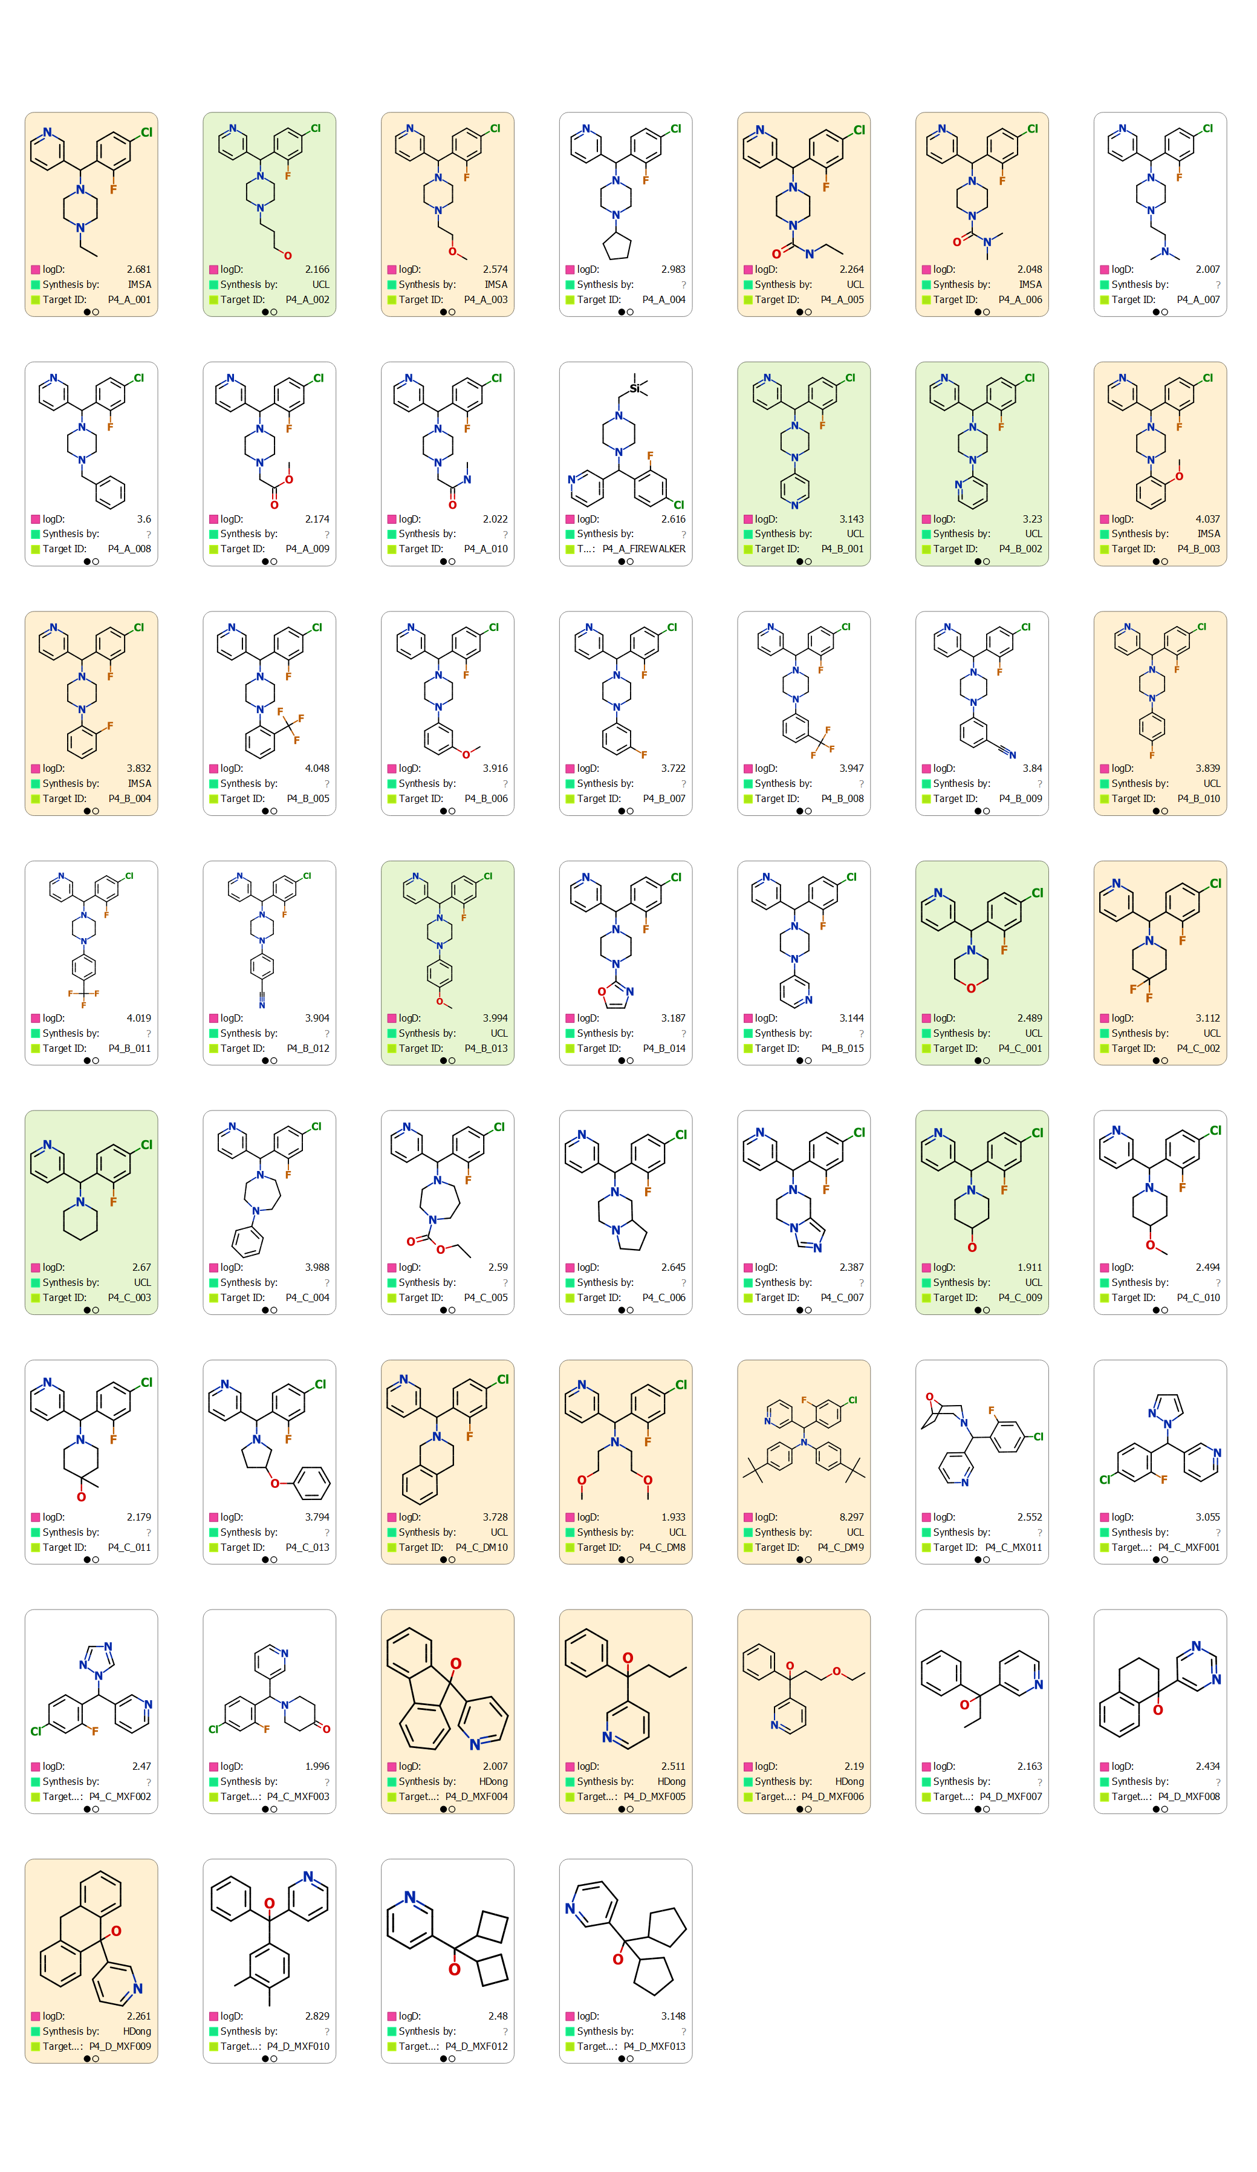
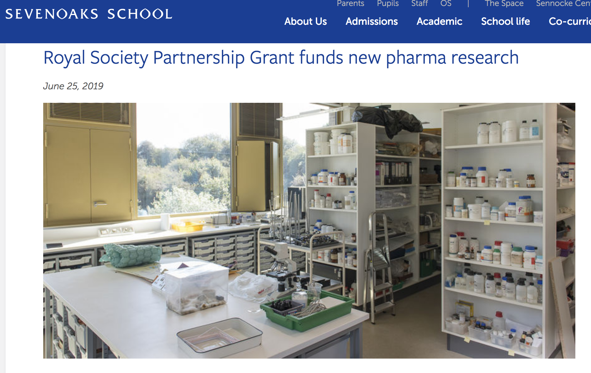
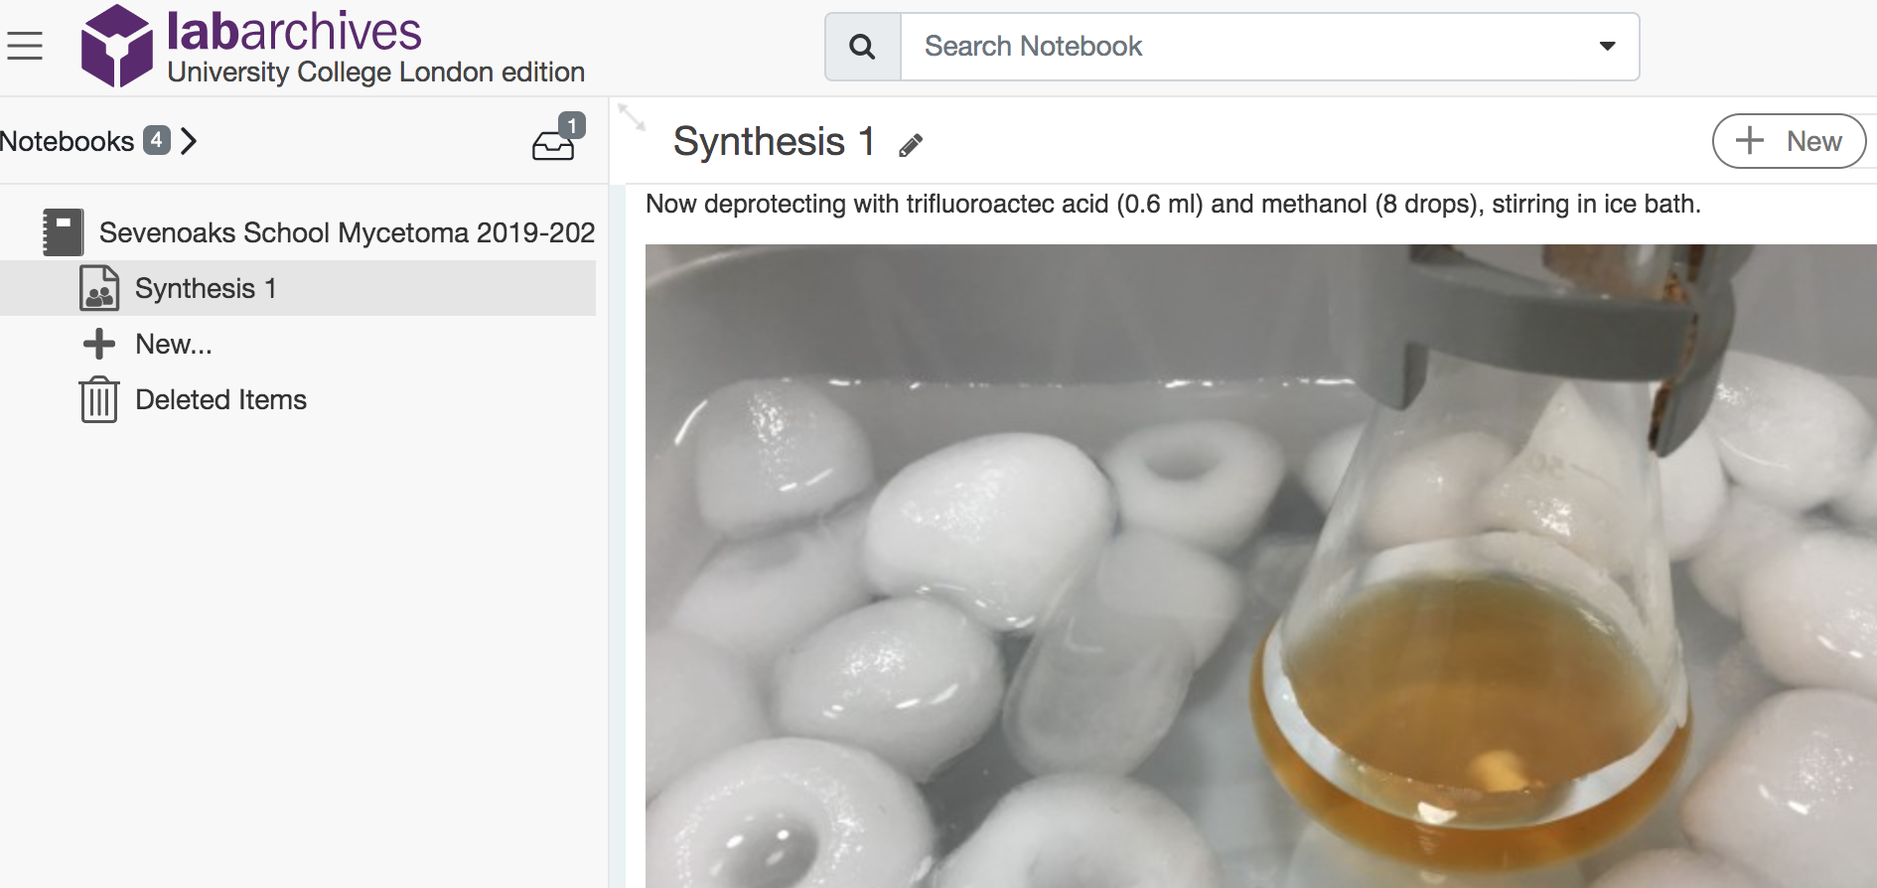
10/11
…Sevenoaks recruits…

Slide 11
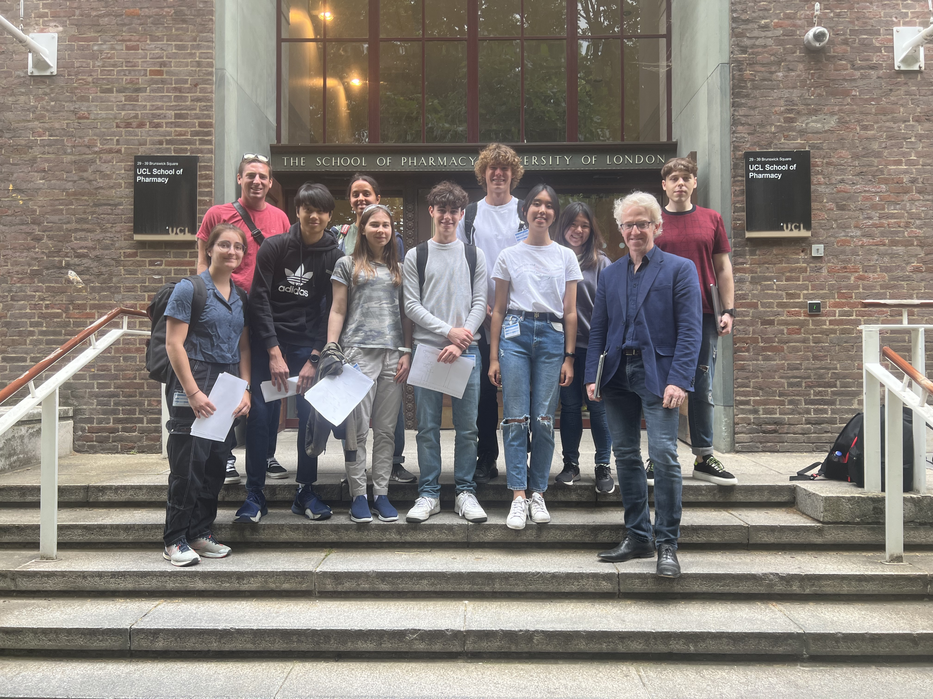
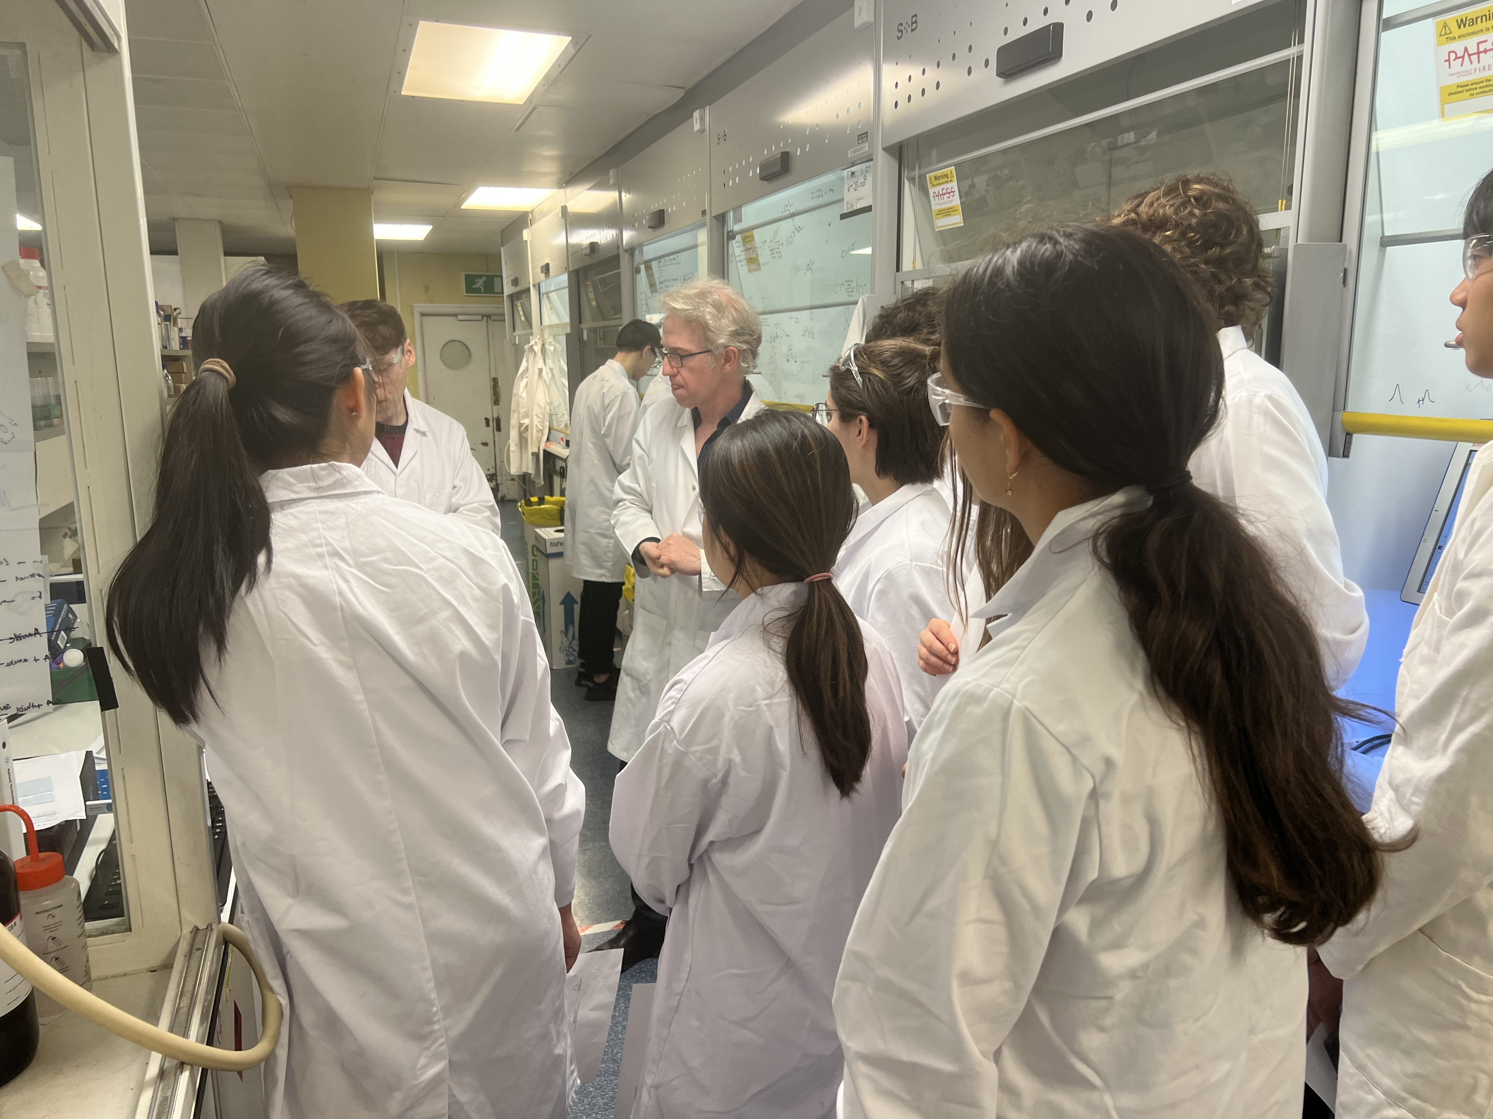
Visit in June!

Slide 12
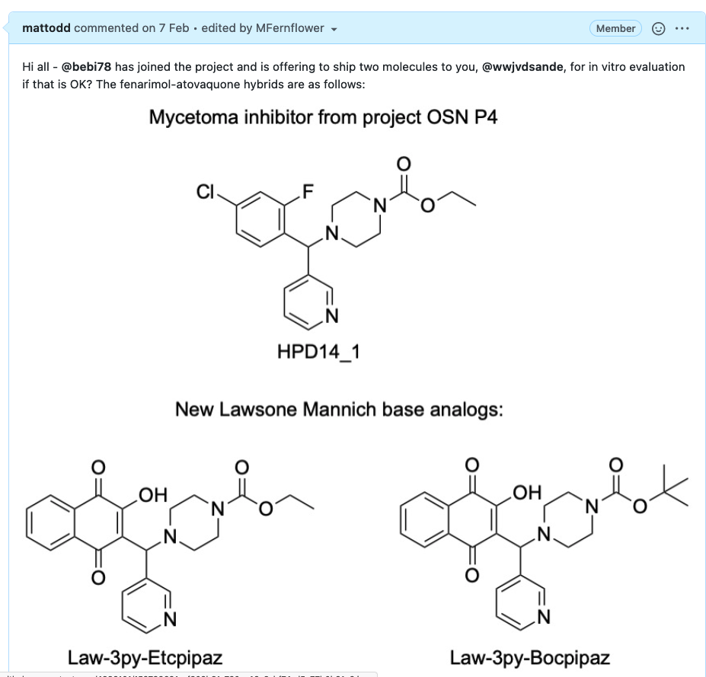
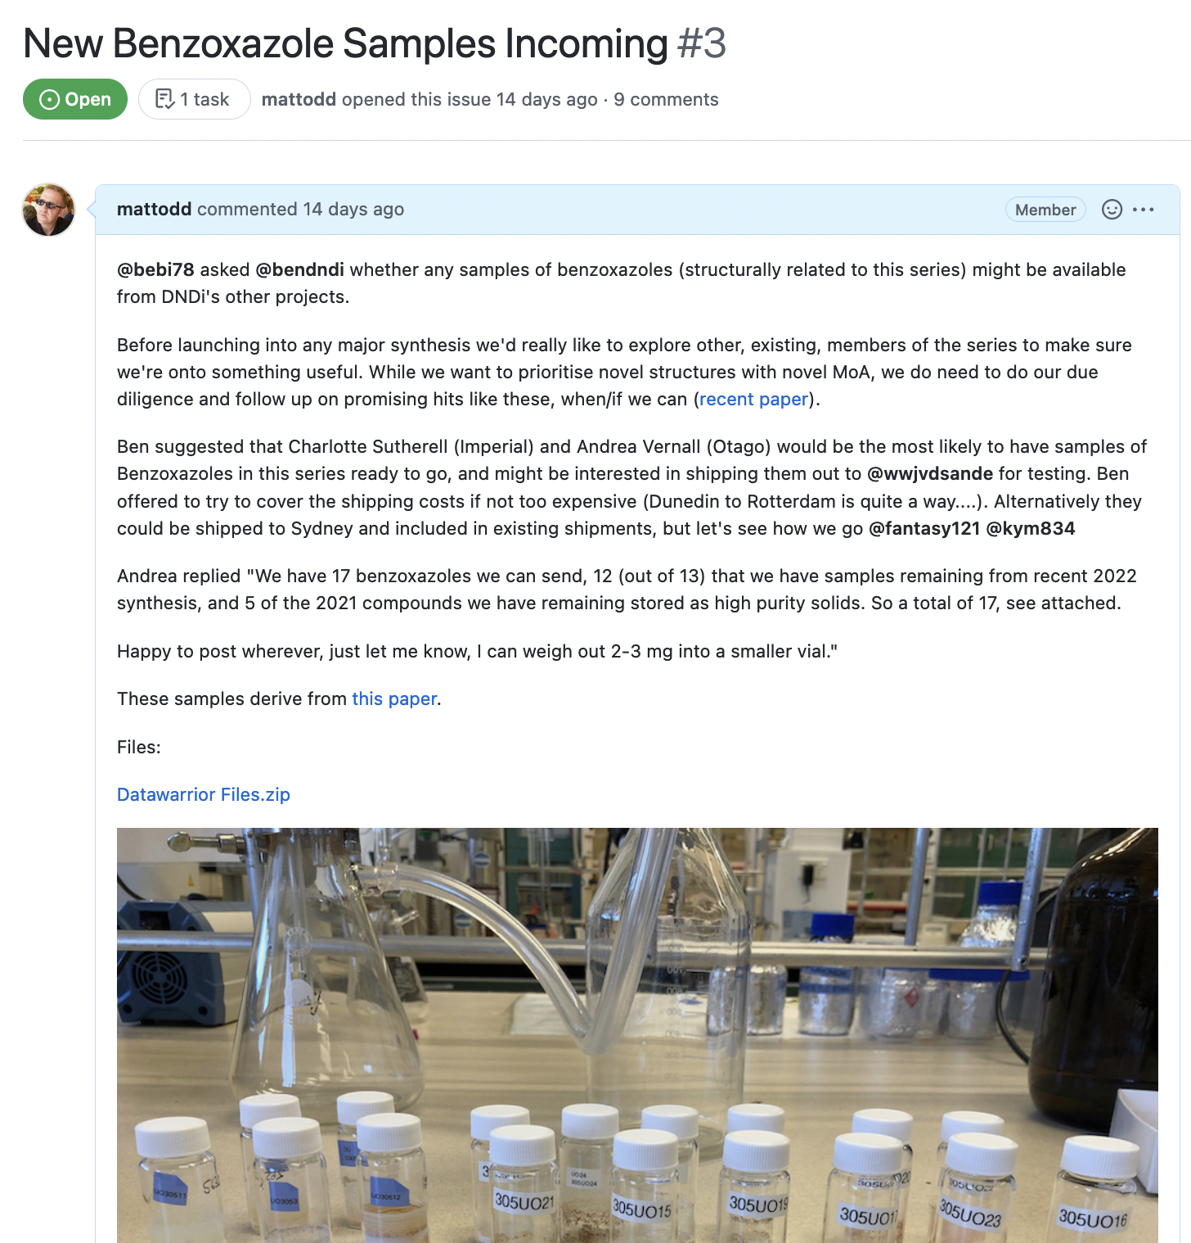
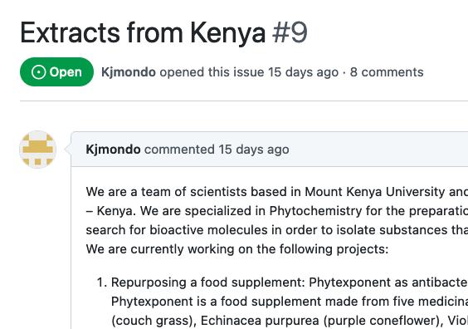
Some 2022 Contributions
https://github.com/OpenSourceMycetoma

Slide 13
Current Series
https://github.com/OpenSourceMycetoma

Slide 14
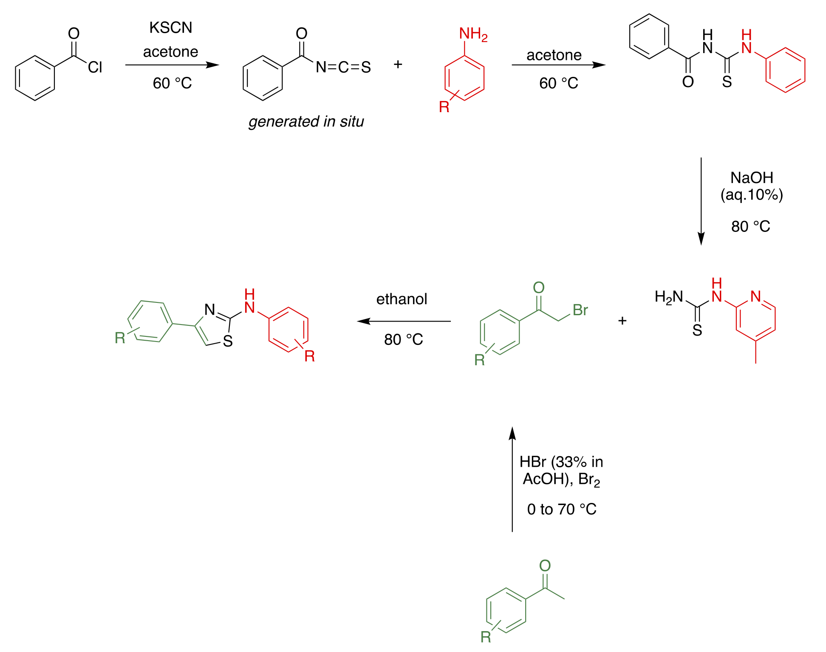
Synthesis Route All Worked Out
https://github.com/OpenSourceMycetoma/Series-2-Aminothiazoles/wiki/General-Synthesis-Route

Slide 15
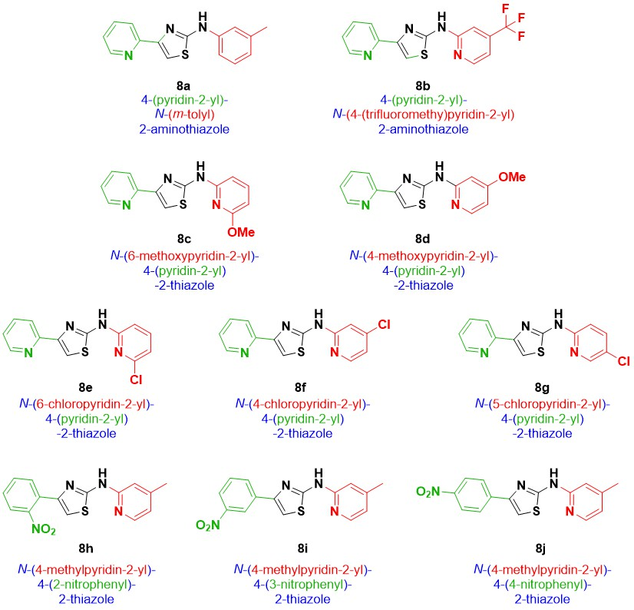
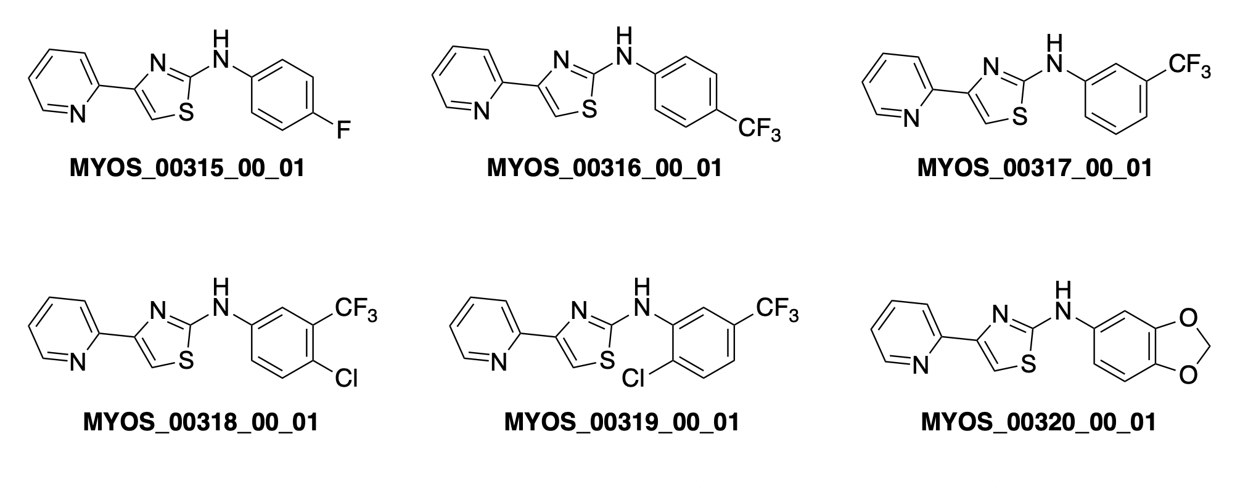
Recently-made Molecules
What should you make?
https://github.com/OpenSourceMycetoma/Series-2-Aminothiazoles/issues/10

Slide 16

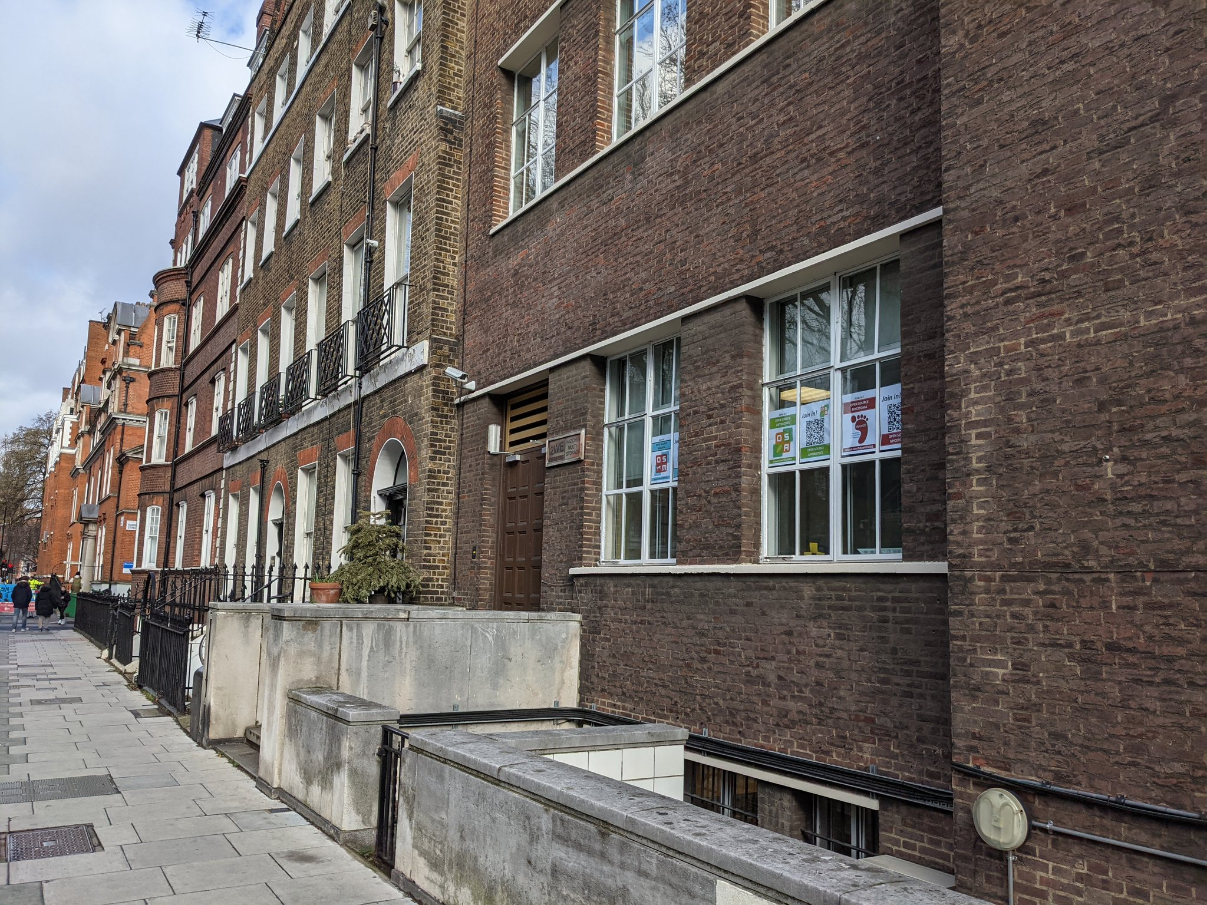
Advertising you can download
https://github.com/OpenSourceMycetoma/Talks-Meetings-Publicity/tree/master/File%20Diary/2022/Window%20Posters

Slide 17
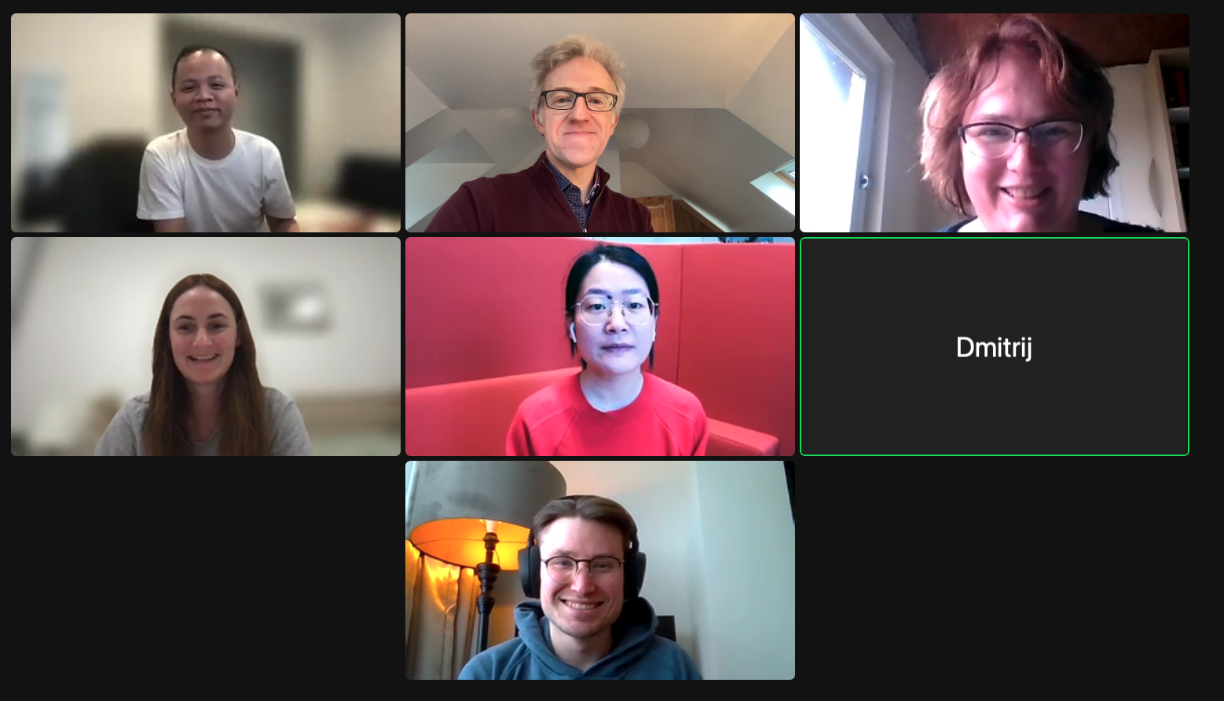
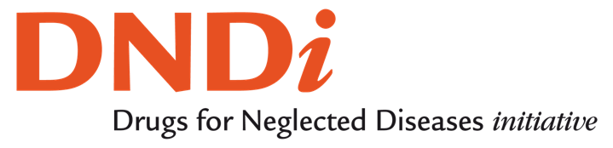



Courageous People, Courageous Funders
Wendy van de Sande and team at Erasmus MC, Rotterdam
Hung Phat Duong, Kymberley Scroggie, Alice Williamson at Sydney Uni
Dmitrij Melechov at UCL
Antony Sama in New York City
The Teachers and Students at Sevenoaks School, Kent
…and more!

